Slide 1
Principles of Incident Management
CGPRT(W) : Ensuring Clean Seas and Coasts in Western Region ……

Slide 2
Objective
To understand that a properly implemented and coordinated management system will improve the efficiency and effectiveness of emergency response operations, regardless of the nature of the incident
To provide strategic guidance on the development and implementation of a management system that meets your needs
CGPRT(W) : Ensuring Clean Seas and Coasts in Western Region ……

Slide 3
Introduction
The early stages of a response incident are often confused and stressful with competing priorities, few resources and little information
Effective incident management requires turning this opening “crisis ” phase into a structured response in the shortest possible period: “Crisis to Project”
This can best be achieved by utilizing an incident management system (IMS)
CGPRT(W) : Ensuring Clean Seas and Coasts in Western Region ……

Slide 4
Introduction
There are a range of response systems employed worldwide.
We will consider the principles of an IMS that can be applied to a range of response situations and organizational structures.
You will consider which system best meets your needs.
CGPRT(W) : Ensuring Clean Seas and Coasts in Western Region ……

Slide 5
Introduction
An Incident Management System (IMS) is essential for an effective response
Ensures that all essential functions of a response are taken care of
Ensures control of response actions
Ensures coordination of resources
Ensures the development of incident action plan
CGPRT(W) : Ensuring Clean Seas and Coasts in Western Region ……

Slide 6
Introduction
Authoritative command is carried out by those who have been given authority over others for a specific operation or incident
Incident commanders should:
Make decisions
Give clear directions
Ensure these directions are carried out
This promotes cohesion and provides direction to deliver the response strategy
CGPRT(W) : Ensuring Clean Seas and Coasts in Western Region ……

Slide 7
Introduction
In the response to an incident our response objectives are established at the strategic level
At the tactical level we turn these objectives into an incident (action) response plan
An IMS ensures a structured and flexible response organization to develop and manage our response plan
CGPRT(W) : Ensuring Clean Seas and Coasts in Western Region ……

Slide 8
Introduction
CGPRT(W) : Ensuring Clean Seas and Coasts in Western Region ……

Slide 9
Introduction
The identification and consideration of tactical options will help deliver a tactical plan that contains the most suitable options to deliver the strategy
The options chosen must consider the following factors:
NEBA
Technical reasonableness
Capacity
Capability
CGPRT(W) : Ensuring Clean Seas and Coasts in Western Region ……

Slide 10
NEBA
Net Environmental Benefit Analysis (NEBA)
A process for making the best choices to minimize the impacts of oil spills on people and the environment
Aims to decrease the overall effect of oil on the environmental and economic resources whilst achieving an acceptable standard of clean up
CGPRT(W) : Ensuring Clean Seas and Coasts in Western Region ……

Slide 11
Tactical Considerations
In summary:
Is it technically reasonable?
Does it meet our NEBA criteria and considerations?
Is it allowed under our regulations?
Do we have the resources?
Can we monitor the effectiveness?
CGPRT(W) : Ensuring Clean Seas and Coasts in Western Region ……

Slide 12
Definitions
Command
The internal direction of members and resources of an organization in the performance of that organization’s role and tasks
Command operates vertically within a single organization
CGPRT(W) : Ensuring Clean Seas and Coasts in Western Region ……

Slide 13
Definitions
Control
The overall direction of response activities in an emergency situation
Control relates to situations and operates across multiple organizations
Authority for control is established in legislation or by agreements
It carries with it the responsibility for tasking other organizations
It should be defined in the Contingency Plan
CGPRT(W) : Ensuring Clean Seas and Coasts in Western Region ……

Slide 14
Definitions
Coordination
The bringing together of organizations and resources to ensure a consistent and effective response to an incident
Coordination generally refers to the allocation or commitment of resources of an organization to the response
CGPRT(W) : Ensuring Clean Seas and Coasts in Western Region ……

Slide 15
Response Planning Cycle
Effective management requires a systematic approach
This is a continual process of identifying and addressing the unique risks posed by a particular incident
In the simplest form this process has four steps:
Incident assessment
Planning and decision-making
Implementation
Monitoring and review
CGPRT(W) : Ensuring Clean Seas and Coasts in Western Region ……

Slide 16
Response Planning Cycle
Monitoring and review
Incident assessment (situation)
Implementation
(operations)
Planning and decision-making
CGPRT(W) : Ensuring Clean Seas and Coasts in Western Region ……

Slide 17
Response Planning Cycle
Incident assessment
Evaluation of the incident, in particular the identification and prioritization of the environmental and socio-economic resources threatened by the incident
Planning and decision-making
The development, consideration and selection of appropriate strategies to respond to the incident
CGPRT(W) : Ensuring Clean Seas and Coasts in Western Region ……

Slide 18
Response Planning Cycle
Implementation
The operational implementation of the selected response strategies
Monitoring and review
Putting in place mechanisms to evaluate the effectiveness of the implemented response strategies and to measure progress towards the response objectives and, ultimately, terminating the response
CGPRT(W) : Ensuring Clean Seas and Coasts in Western Region ……

Slide 19
Incident Response Objectives
An effective response requires the implementation of a series of actions to meet the overall objectives:
Objectives are a statement of intent for the incident response and should clearly describe the intended outcome for the response
Response actions should be measured against the incident objectives
Incident objectives should be achievable, measurable, include an intent, a time parameter (when) and a space parameter (where)
CGPRT(W) : Ensuring Clean Seas and Coasts in Western Region ……

Slide 20
Incident Action Plan
The Incident Action Plan (IAP) pulls together the incident objectives, strategies and tactics
An IAP is developed for a specified period of time
It describes the activities and logistical support required during that period
It is a “living document” and subject to amendment and updating as the latest information is received
CGPRT(W) : Ensuring Clean Seas and Coasts in Western Region ……

Slide 21
Incident Action Plan
Incident Action Plan
Typically includes the following sections
Situation
Area affected, sensitivities, actions taken
Objectives
What is the response trying to achieve?
Operations
Strategies and tactics
Deadline for completion
Administration and logistics
Describes elements required to support response
Reporting arrangements
CGPRT(W) : Ensuring Clean Seas and Coasts in Western Region ……

Slide 22
Span of Control
This refers to the number of personnel or functions that an individual can manage effectively
In general the span of control for any single position falls between three and seven
It is generally considered that five is the optimal number of functions to report to one individual for an emergency response
This can rise depending on the incident and the individual’s expertise
CGPRT(W) : Ensuring Clean Seas and Coasts in Western Region ……

Slide 23
Incident Management
Incident management systems are generally built around five MAJOR functions:
Command
Planning
Operations
Logistics
Finance
These functions are delivered through an incident management team
Command Function
Planning Function
Logistics
Function
Finance Function
Operations Function
CGPRT(W) : Ensuring Clean Seas and Coasts in Western Region ……

Slide 24
Incident Command
Command function is responsible for:
The overall management of an incident
Setting the objectives of the response
Setting the priorities of the response
In addition it may also be responsible for:
Public affairs and media liaison
Legal issues
Overall incident safety
Inter-agency liaison
Inter-region liaison
CGPRT(W) : Ensuring Clean Seas and Coasts in Western Region ……

Slide 25
Incident Command
Generally a single individual or organization will fulfil the command function
If the incident is complex with a large number of stakeholders (government to government internationally, national and local government agencies, industry, etc.) it may be appropriate to implement a combined command function
This must be defined in the IAP so that the responsibilities of the different organizations are clearly understood
CGPRT(W) : Ensuring Clean Seas and Coasts in Western Region ……

Slide 26
Operations Function
The Operations function is responsible for the management of all activities within the incident and the management of all resources deployed in the field
Operations are organized into divisions on the basis of geography or the operations being conducted according to the type, demands and complexity of the incident
Divisions can be further broken into sectors, teams or resources as required
CGPRT(W) : Ensuring Clean Seas and Coasts in Western Region ……

Slide 27
Operations Function
Operations Function
Aviation Division
Health & Safety
Waste Management
Shoreline Division
Wildlife Division
Marine Division
Aerial Dispersants
Aerial Surveillance
Marine Containment & Recovery
Marine Dispersants
Sector A
Sector B
Response Team B
Response Team A
Response Team A
Response Team B
A typical layout: Must be adjusted to fit your incident
CGPRT(W) : Ensuring Clean Seas and Coasts in Western Region ……

Slide 28
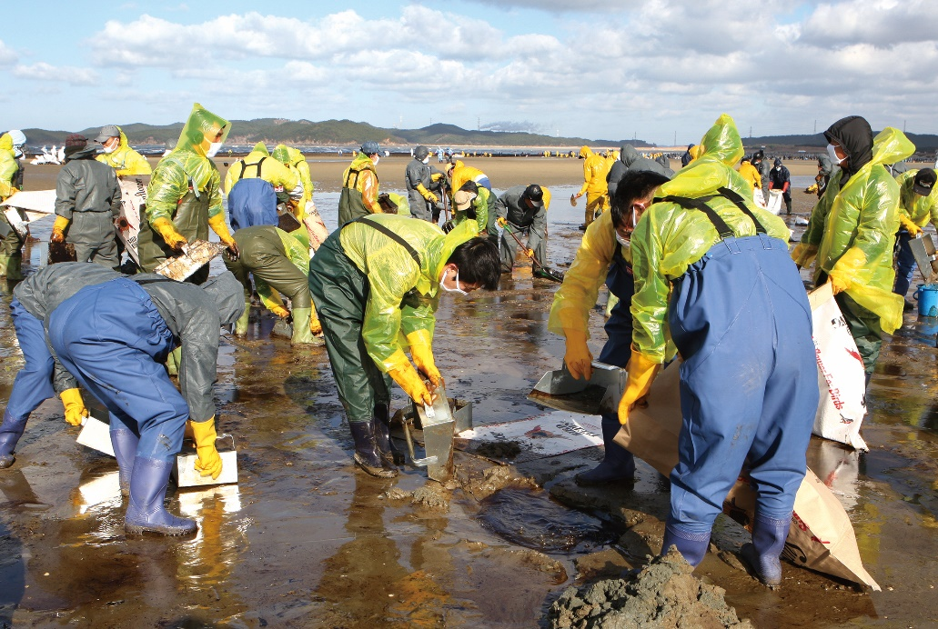
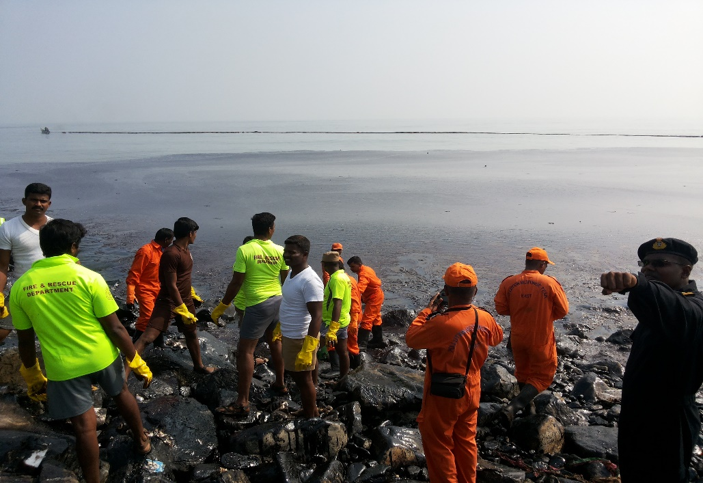
IMS - Operations
CGPRT(W) : Ensuring Clean Seas and Coasts in Western Region ……

Slide 29
Response Teams
Identified sectors will be controlled by a Beach supervisor/Manager
Responsible for the clean-up operations within the sector
Supported by response teams
Headed by a Team Leader
CGPRT(W) : Ensuring Clean Seas and Coasts in Western Region ……

Slide 30
Use of Volunteers
In the event of a manual clean-up operation the use of volunteers may be considered
If this is considered then issues of liability and health and safety regulations need to be addressed
Legal release of liability
Safety and operational training
Suitable job roles and responsibilities
Sufficient and appropriate PPE
CGPRT(W) : Ensuring Clean Seas and Coasts in Western Region ……

Slide 31
Use of Volunteers
Advantages
Local knowledge (especially fishermen or shore/water users)
Effective way of filling manpower requirements
Volunteers have a stake in the local environment
CGPRT(W) : Ensuring Clean Seas and Coasts in Western Region ……

Slide 32
Use of Volunteers
Disadvantages
Often untrained in spill response operations and health and safety so will require training and close supervision
Will require PPE, supplies, logistical support and on-site management and supervision
Cannot be relied upon to assist daily or for long periods
May be insurance cost implications
May cause tension with professional, paid, staff
CGPRT(W) : Ensuring Clean Seas and Coasts in Western Region ……

Slide 33
Use of Vessels of Opportunity in Spill Response
Depending on the nature of the oil spill, there may be a need to mobilize ‘Vessels of Opportunity’ to assist in the response
Typically owned and operated by professional or recreational fishermen dedicated to capturing fish, gathering shellfish or to aquaculture, but may include other boat operators.
Fishermen in oil spill response may be effective in coastal sea areas due to:
Local knowledge of the shoreline and coastal waters
Availability of fishing gear that may be useful for recovery operations
Availability to offer their collaboration.
CGPRT(W) : Ensuring Clean Seas and Coasts in Western Region ……

Slide 34
Examples of Roles and Tasks for Vessels of Opportunity
Fishermen – deploy traditional gears, booms and trawl nets for oil containment and recovery
Fish farmers – use ropes, bags, nets, cages, tanks and barges which may be useful in oil recovery, transporting waste/people, or preventing oil from reaching the shoreline
Shellfish farmers – drive barges to conduct surveys in shallow waters, assist protection of sensitive sites
Kelp harvesters – recover thick viscous oil with their on-board gear and store it on board
Divers – assist submerged slick recovery operations or assist set up boom mooring systems
Other boat operators – transport responders or observers, provision of logistical support
CGPRT(W) : Ensuring Clean Seas and Coasts in Western Region ……

Slide 35
Possible Response Operations by Vessels of Opportunity
Alert, surveying and sampling
Oiled shoreline assessment – particularly where access from the sea is necessary
Response operations:
Chemical dispersion
Containment
Recovery operations
Protection of the shoreline
Waste storage and transportation
Wildlife recovery and rescue
Logistical support
CGPRT(W) : Ensuring Clean Seas and Coasts in Western Region ……

Slide 36
Elements to Consider in using Vessels of Opportunity
Adherence to relevant national regulation on the use of Vessels of Opportunity where applicable
Health and Safety aspects addressed
Effectiveness of deployment considered
Integration of fishermen/VOOs within the chain of command
Coordinator/manager within spill management team responsible for their deployment and activities
Communication system among operators for unambiguous flow of information
Definition of their specific roles and responsibilities
Delivery of on-the-spot training courses
Daily updates
Payment and compensation
CGPRT(W) : Ensuring Clean Seas and Coasts in Western Region ……

Slide 37
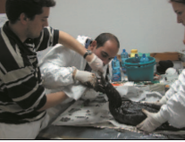
Wildlife
This unit is responsible for:
The development of guidelines and advice for the handling of affected wildlife
The recovery, identification, storage and disposal, including post-mortem, of any deceased wildlife
The provision of advice to members of the public
The establishment of collection, cleaning and rehabilitation centres
CGPRT(W) : Ensuring Clean Seas and Coasts in Western Region ……

Slide 38
Operational Health and Safety
The Health and Safety function with Operations is to provide operational guidelines and oversight of work practices during response operations
The safety of response personnel and the public is paramount
The development of specific and appropriate guidelines and the monitoring of operations to ensure safe working conditions is required throughout the response
CGPRT(W) : Ensuring Clean Seas and Coasts in Western Region ……

Slide 39
Waste Management
Waste management should be addressed at a very early stage in the response operations
Waste management discipline should be imposed quickly at every stage of the response to minimize waste and subsequent treatment
Consideration should be given to the establishment of both temporary and long-term storage facilities, as well as transportation and final disposal requirements
CGPRT(W) : Ensuring Clean Seas and Coasts in Western Region ……

Slide 40
Planning Function
Planning function is responsible for information management and the development of the IAP
Information managed will include:
Situational data
Resources deployment and tracking
Environmental, scientific and technical advice
The planning function is also responsible for the development of incident specific response plans
CGPRT(W) : Ensuring Clean Seas and Coasts in Western Region ……

Slide 41
Planning Function
Planning function
Situation/Intelligence
Environment
Response planning
Resource deployment
Technical support
CGPRT(W) : Ensuring Clean Seas and Coasts in Western Region ……

Slide 42
Planning Function
Situation/Intelligence
The collection, evaluation and dissemination of information on the current and forecast situation
May include environmental resource information, spill trajectory modelling, collation of aerial and shoreline observation reports, etc.
CGPRT(W) : Ensuring Clean Seas and Coasts in Western Region ……

Slide 43
Planning Function
Environment
Includes natural, social, cultural and economic resources
Requires up to date and coordinated information about the resources at risk within a given area
Identifies and prioritizes resources at risk, acceptable methods of clean-up and the end-point at which clean-up activities should cease (the termination criteria)
CGPRT(W) : Ensuring Clean Seas and Coasts in Western Region ……

Slide 44
Planning Function
Resource deployment
The collection and maintenance of information about the resources (personnel, equipment, assets) that have been allocated or deployed
Includes resource tracking, changeover and demobilization
Response planning
Preparation and dissemination of incident specific plans
May coordinate planning meetings
CGPRT(W) : Ensuring Clean Seas and Coasts in Western Region ……

Slide 45
Planning Function
Technical support
Includes specialist technical advisors for specific aspects of the incident
May include public health and safety, hazardous materials, cultural issues, etc.
Could also form part of the Command function, if the incident requires
CGPRT(W) : Ensuring Clean Seas and Coasts in Western Region ……

Slide 46
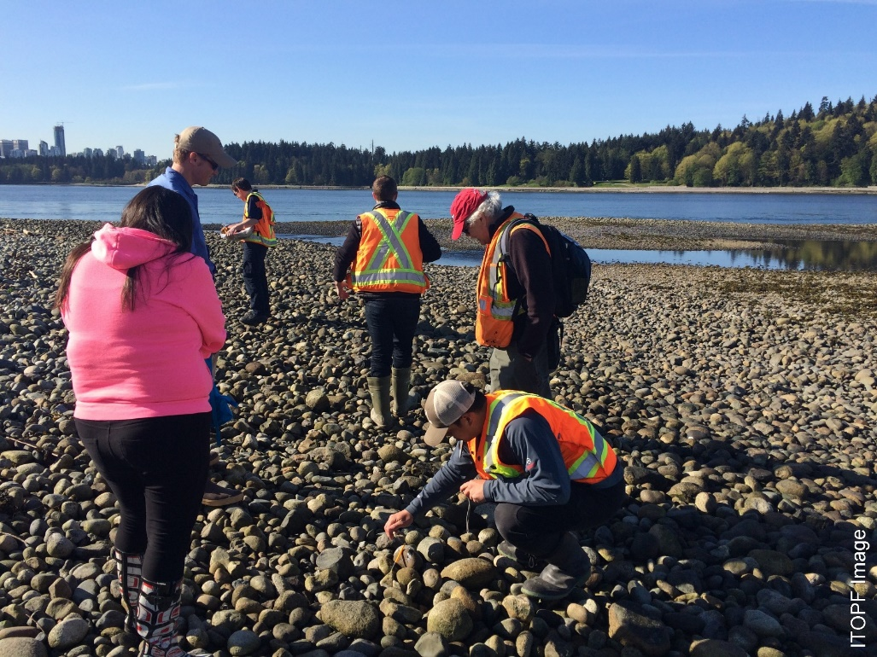
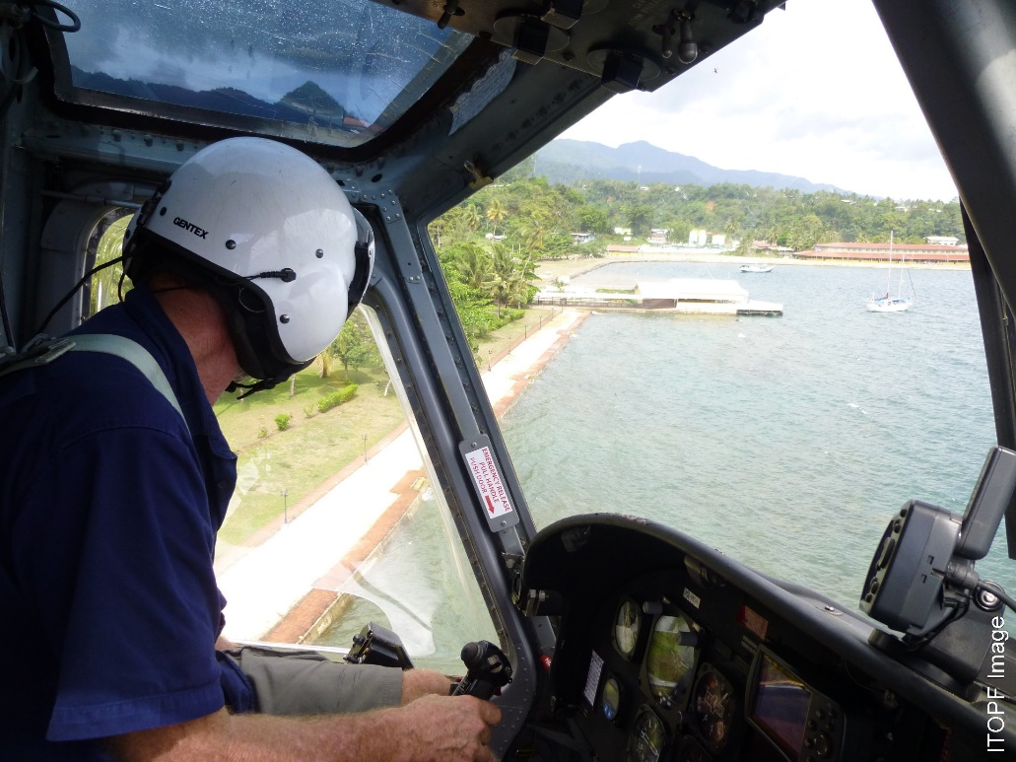
IMS − Planning
CGPRT(W) : Ensuring Clean Seas and Coasts in Western Region ……

Slide 47
Logistics Function
The Logistics function supports the Operations function through the provision and maintenance of all resources and services
There are strong links between logistics and planning due to the implementation of strategies being dependent upon the supply of resources
There are strong links between logistics and finance for purchasing, contracting and tracking
CGPRT(W) : Ensuring Clean Seas and Coasts in Western Region ……

Slide 48
Logistics Function
Logistics Function
Supply
Communications Support
Facilities Support
Transport Support
Subsistence
CGPRT(W) : Ensuring Clean Seas and Coasts in Western Region ……

Slide 49
Logistics Function
Supply
The acquisition, distribution, storage and maintenance of equipment, materials and other response resources for the response operations
If insufficient resources are available the Supply Function should obtain additional resources as required
Supply requirements should be forecast through the planning process
CGPRT(W) : Ensuring Clean Seas and Coasts in Western Region ……

Slide 50
Logistics Function
Communications support
The acquisition, maintenance and installation of communications and IT equipment to support the response
May also provide technical advice and support to the planning and operations functions
Facilities support
The acquisition, leasing and management of facilities supporting the response including control centres, staging areas, temporary facilities, etc.
CGPRT(W) : Ensuring Clean Seas and Coasts in Western Region ……

Slide 51
Logistics Function
Transport support
This includes the movement of response equipment, personnel or other supplies to where they are required by road, rail, vessel or aircraft
The Transport Support Unit may also be responsible for the mechanical maintenance of vehicles, vessels, etc.
Subsistence
The supply of accommodation, food and drink across the response operation
Can be very complex in large incidents
CGPRT(W) : Ensuring Clean Seas and Coasts in Western Region ……

Slide 52
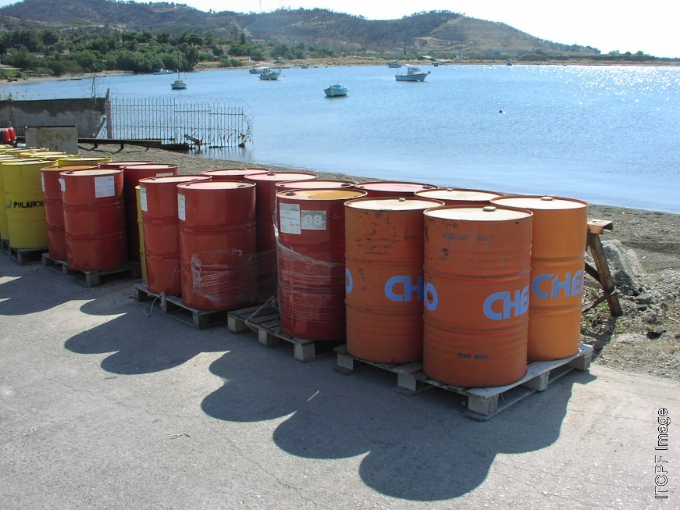
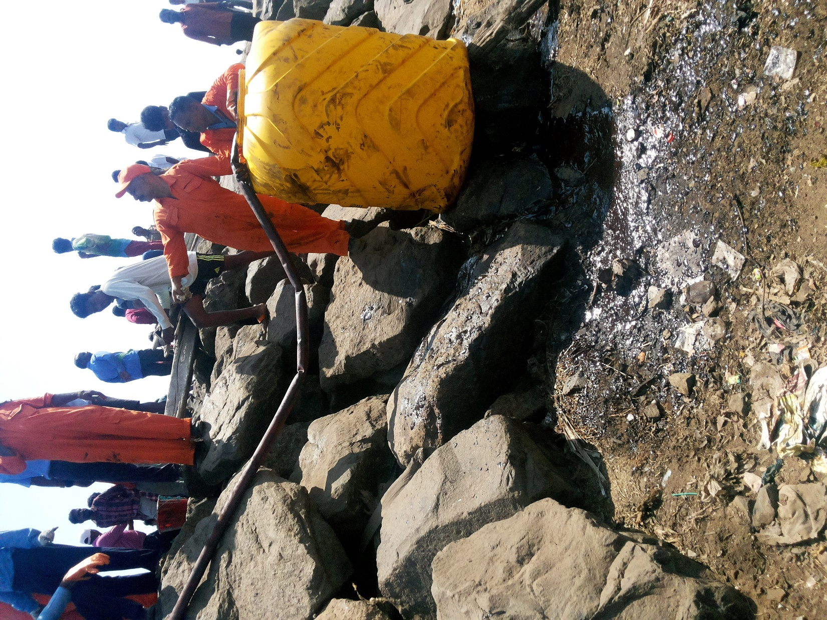
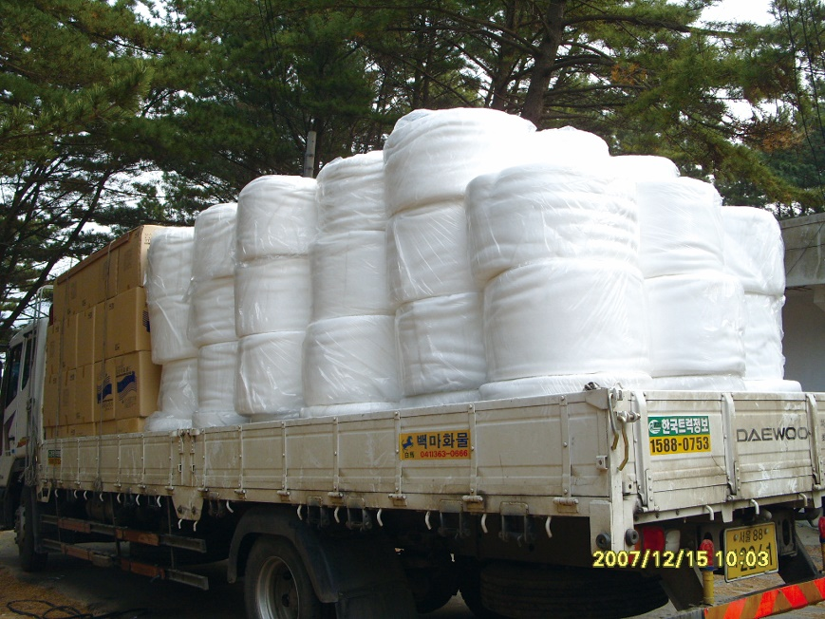
IMS − Logistics
CGPRT(W) : Ensuring Clean Seas and Coasts in Western Region ……

Slide 53
Finance Function
The Finance function issues contracts and monitors and maintains records on costs incurred including the provision of accounting, time recording and cost analyses
This is particularly relevant to cost recovery under the appropriate conventions
In small incidents this may be accommodated within normal agency operations
In multi-agency incidents coordination across agencies may be required
CGPRT(W) : Ensuring Clean Seas and Coasts in Western Region ……

Slide 54
Finance Function
Finance function
Accounts
Insurance / Compensation
Cost recovery
CGPRT(W) : Ensuring Clean Seas and Coasts in Western Region ……

Slide 55
Finance Function
Accounts
The arrangements for the payment of services, materials, etc. procured during response operations.
Insurance/Compensation
May be required to cover losses, damages or injury to response resources and personnel
There may be a need to create a function to address compensation arrangements. This is unlikely if the IOPC Fund is involved.
CGPRT(W) : Ensuring Clean Seas and Coasts in Western Region ……

Slide 56
Finance Function
Cost recovery
The polluter-pays principle is fundamental in responding to pollution incidents
The preparation of claims and, in particular, coordination across agencies requires special attention
Consideration should be given to the early contact and exchange of information with insurers, IOPC Fund, etc., on anticipated costs
CGPRT(W) : Ensuring Clean Seas and Coasts in Western Region ……

Slide 57
Response Organization Complexity
The IMS systems described can be expanded or contracted to meet the management needs of any type or size of incident
As a minimum only the Command function is required to be filled
Once the recommended span of control is exceeded then the functions need to be delegated through expansion
CGPRT(W) : Ensuring Clean Seas and Coasts in Western Region ……

Slide 58
Response Organization Complexity
Response frameworks (IMS) vary from country to country
Industry, especially major multi-national presence industry, may have their own in-house systems
These must be adapted to align with the host country approach
CGPRT(W) : Ensuring Clean Seas and Coasts in Western Region ……

Slide 59
Response Organization Complexity
Generally IMS models fall into three styles defined as:
Single Command;
Coordinated Command; and
Unified Command
Single Command:
Typical small scale incident with a single structure with government authorities in charge or industry owner/operator in charge with government oversight
CGPRT(W) : Ensuring Clean Seas and Coasts in Western Region ……

Slide 60
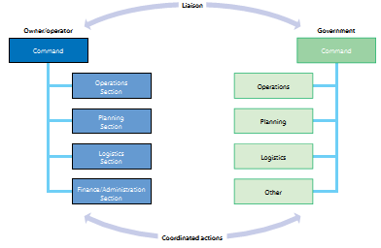
Response Organization Complexity
Coordinated Command:
Government and industry (or neighbouring country) responding in parallel to an incident
Coordination of activities and alignment in decision- making achieved through close liaison of Command posts
CGPRT(W) : Ensuring Clean Seas and Coasts in Western Region ……

Slide 61
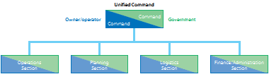
Response Organization Complexity
Unified Command:
Government and industry (or neighbouring country) form a Joint Command
Manage the incident under a fully integrated IMS structure operating
CGPRT(W) : Ensuring Clean Seas and Coasts in Western Region ……

Slide 62
Incident Facilities
Major incidents require a number of facilities to effectively manage an incident
These may include:
Incident Command Centre (ICC)
Forward Command Point(s) (FCP)
Staging or assembly areas
Temporary waste storage areas
Decontamination areas
Joint Information Centre
CGPRT(W) : Ensuring Clean Seas and Coasts in Western Region ……

Slide 63
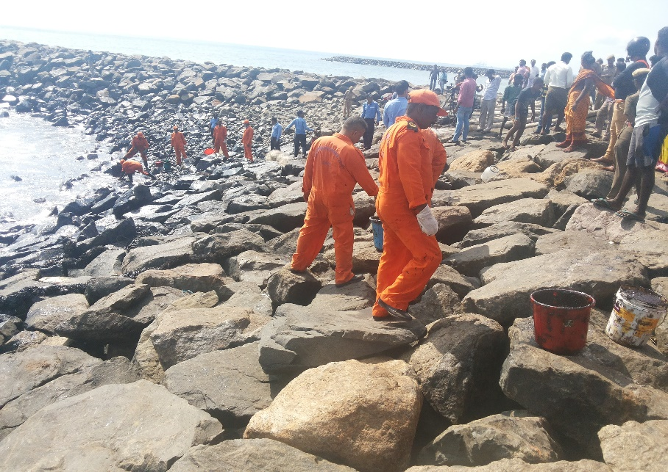
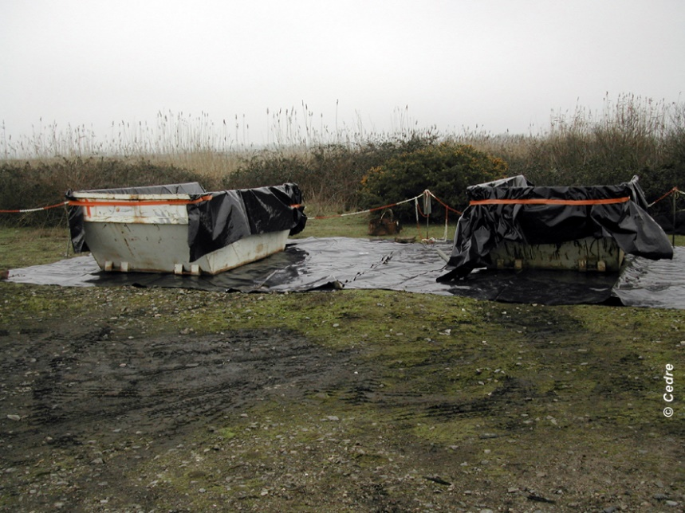
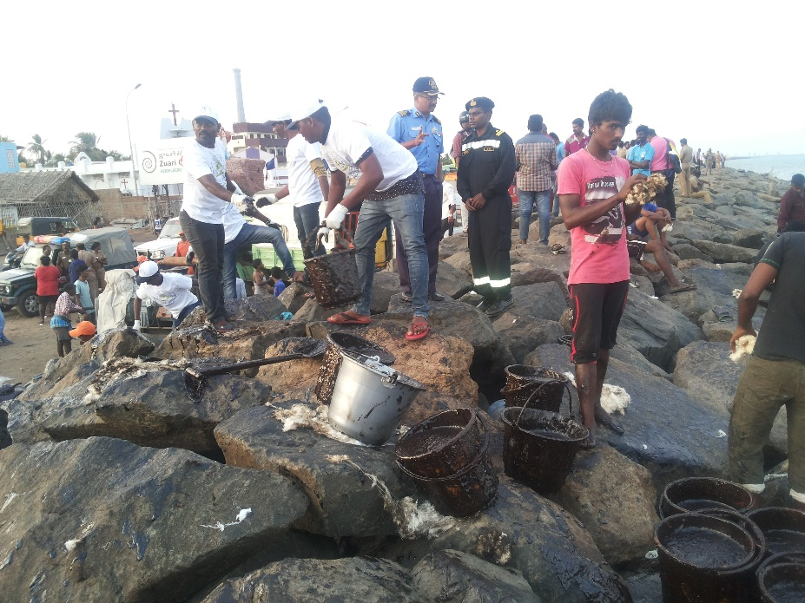
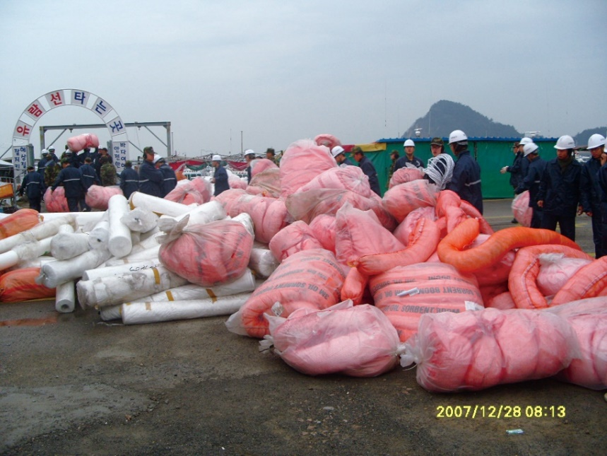
Incident Facilities
CGPRT(W) : Ensuring Clean Seas and Coasts in Western Region ……

Slide 64
Any questions?
CGPRT(W) : Ensuring Clean Seas and Coasts in Western Region ……

